Slide 1

AUTONOMOUS DATA QUALITY:
ENTERPRISE WIDE SMART CHECKS
TEAM NAME

Slide 2
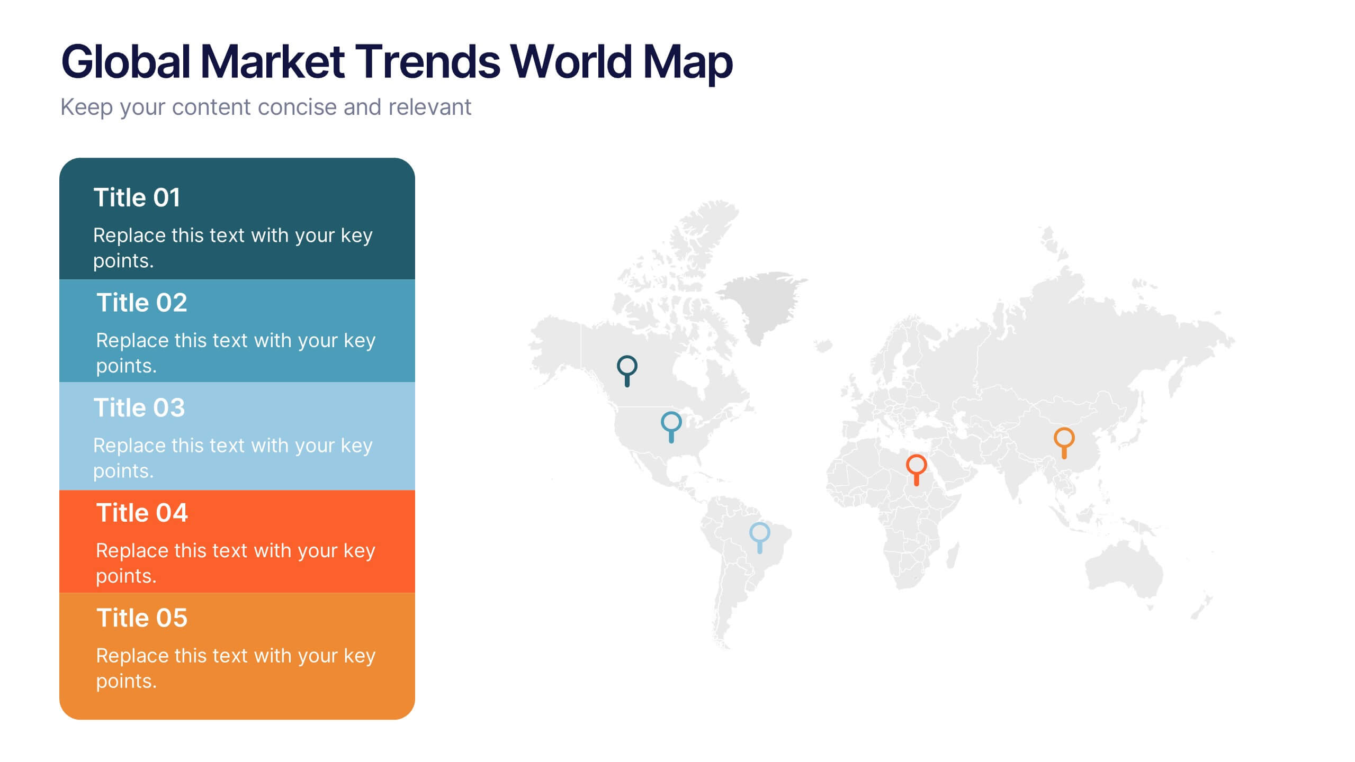
TCS GLOBAL TREND STUDY
Why is data quality important to an organization?
Data quality is crucial an organization because it ensures accurate,reliable and timely information, which supports informed decision making and enhances operational efficiency.
“The 2017 TCS Global Trend Study of more than 800 large companies across North America, Europe, Asia Pacific, and Latin America found that 84% companies are using AI already, and 62% see the technology as important to staying competitive in the year 2020”

Slide 3
Problem statement- Business Context

Slide 4
SOLUTION
Input: Data Streams + Metadata + Business Glossary
Core: AI Agents (Rule Generation, Anomaly Detection, Remediation)
Output: Trusted Data + Explainable Insights + Auditable Rules

Slide 5
Automated Data Validation and Anomaly Detection
Real-time identification of outliers, duplicates, and inconsistencies using ML models.​
Self-learning algorithms flag subtle errors without predefined rules.​
Continuous Learning and Rule Refinement
Models adapt to evolving data patterns by analyzing historical issues and predicting future problems.​
Automatic generation and updating of validation rules from metadata and user feedback.​
Proactive Context-Aware Quality Management
Contextual analysis via LLMs for understanding data semantics and business rules.​
Predictive analytics to anticipate issues before they impact operations.​
Scalable and Transparent with Audit Trails
Handles high-volume streams across multiple sources with full data lineage tracking.​
Explainable AI provides auditable logs and decision rationales for compliance.

Slide 6
Improved Data Trust and Reliability
Up to 95% anomaly resolution, as seen in Vodafone's billing systems, boosting customer satisfaction by 20%.​
25% reduction in data errors and enhanced accuracy through real-time cleansing.​
Reduced Manual Effort and Maintenance Costs
Automates repetitive tasks, freeing staff for strategic work and cutting costs significantly per McKinsey insights.​
80% fewer data quality issues reported by enterprises post-implementation.​
Better Detection of Subtle Data Shifts and Anomalies
Continuous monitoring catches patterns missed by static rules, preventing larger issues.​
Real-time error correction in sectors like retail and healthcare.​
Faster, More Accurate Analytics and Decision-Making
Enables predictive insights and informed decisions with clean, timely data.​
30% increase in customer satisfaction via reliable analytics.

Slide 7
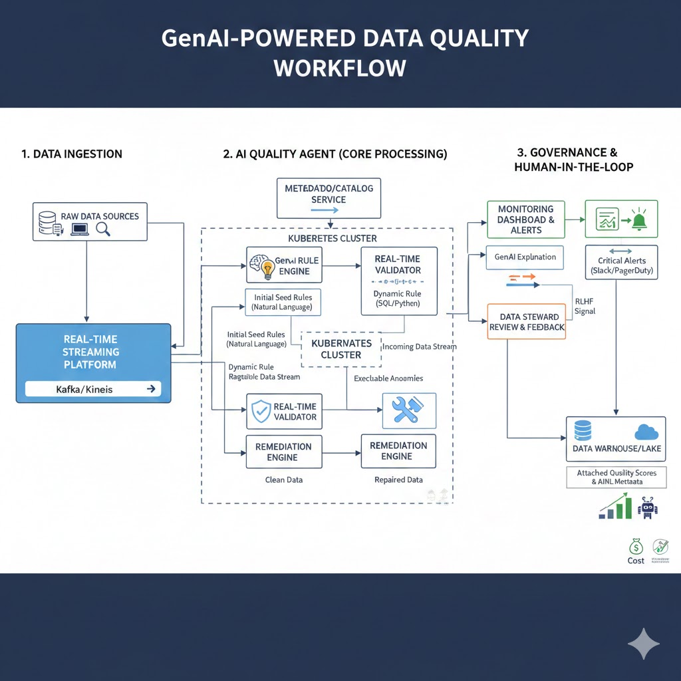
WORKFLOW
Data Ingestion: Securely pulls high-volume feeds from multiple sources.​
AI-Driven Validation & Anomaly Detection: ML scans for errors, outliers in real-time.​
Rule Refinement: Models learn from feedback to auto-update rules dynamically.​
Data Enrichment & Cleansing: Fills gaps, standardizes, and corrects via predictive imputation.​
Continuous Monitoring & Reporting: Dashboards with alerts, audits, and lineage for ongoing oversight.

Slide 8
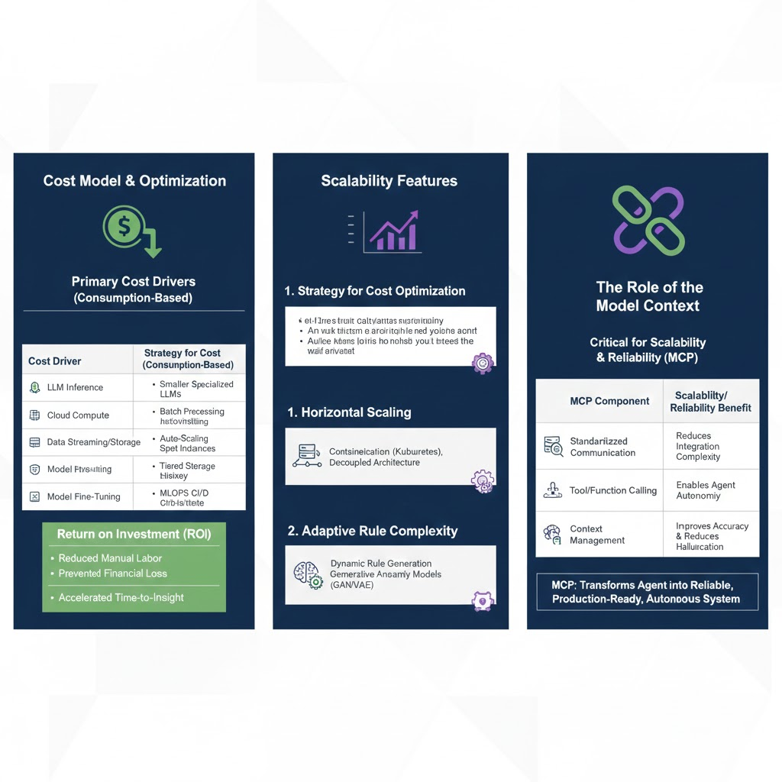

Slide 9
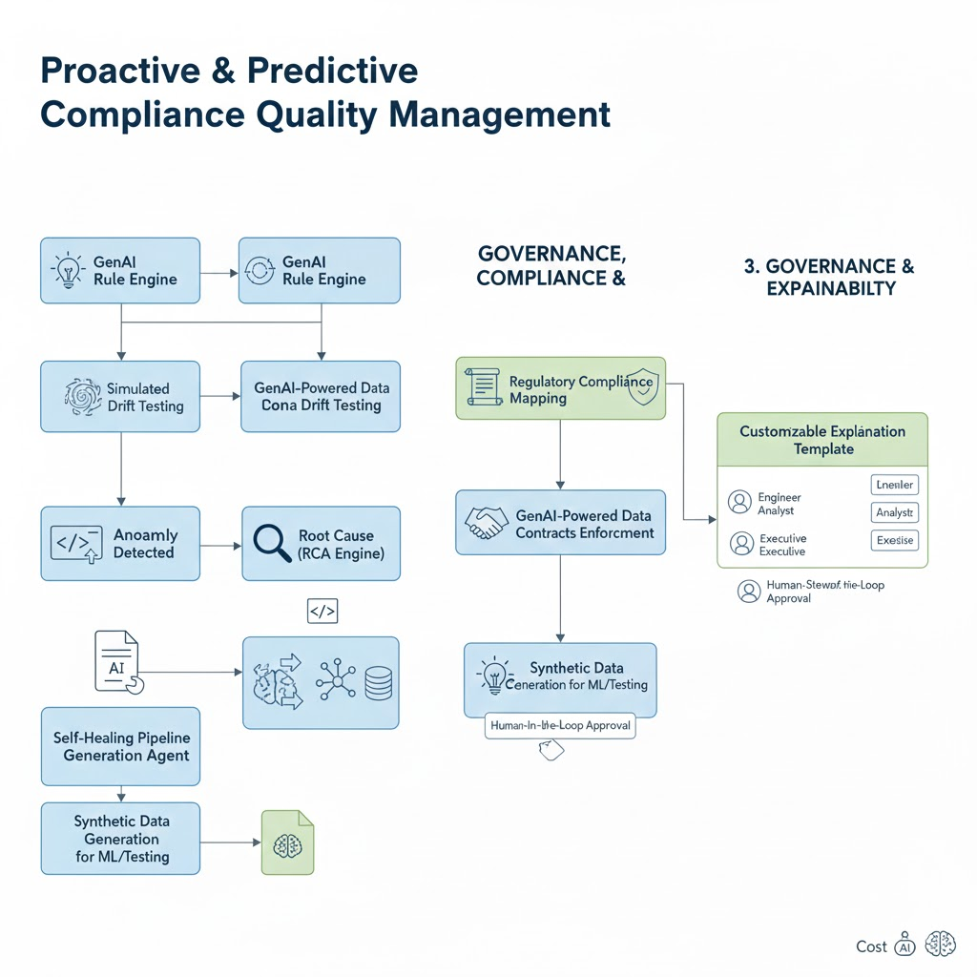

Slide 10
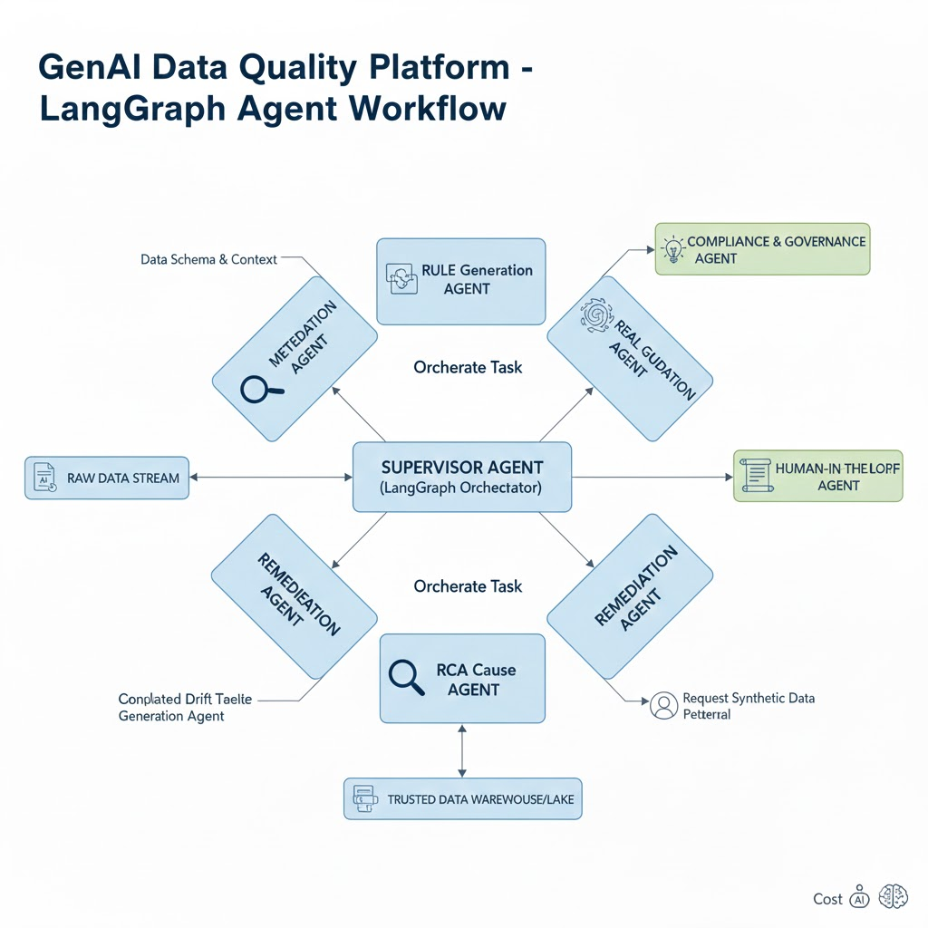

Slide 11
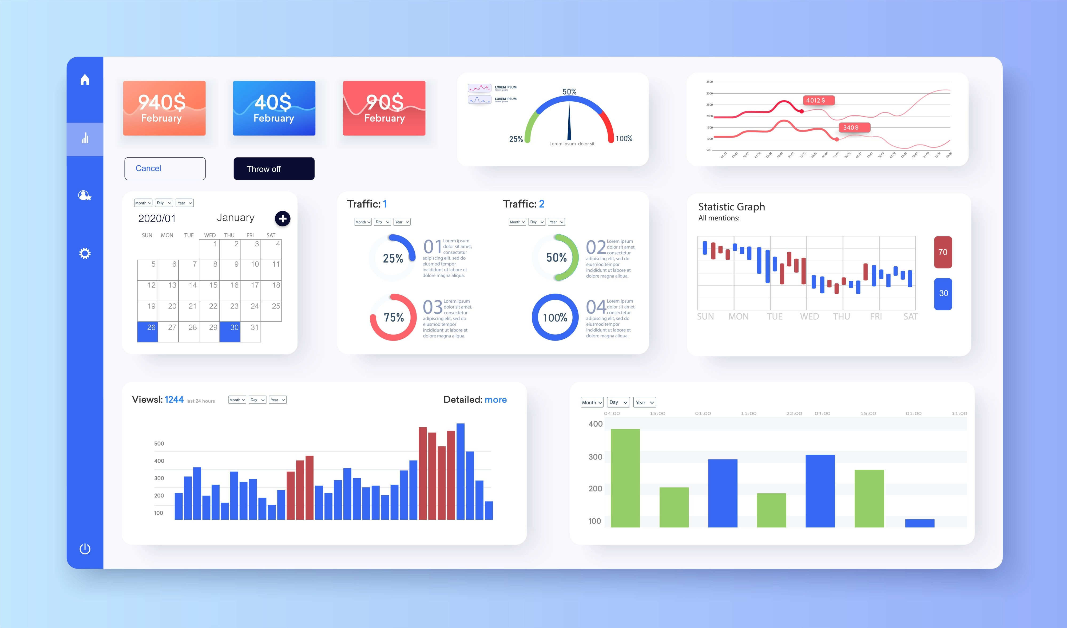

Slide 12
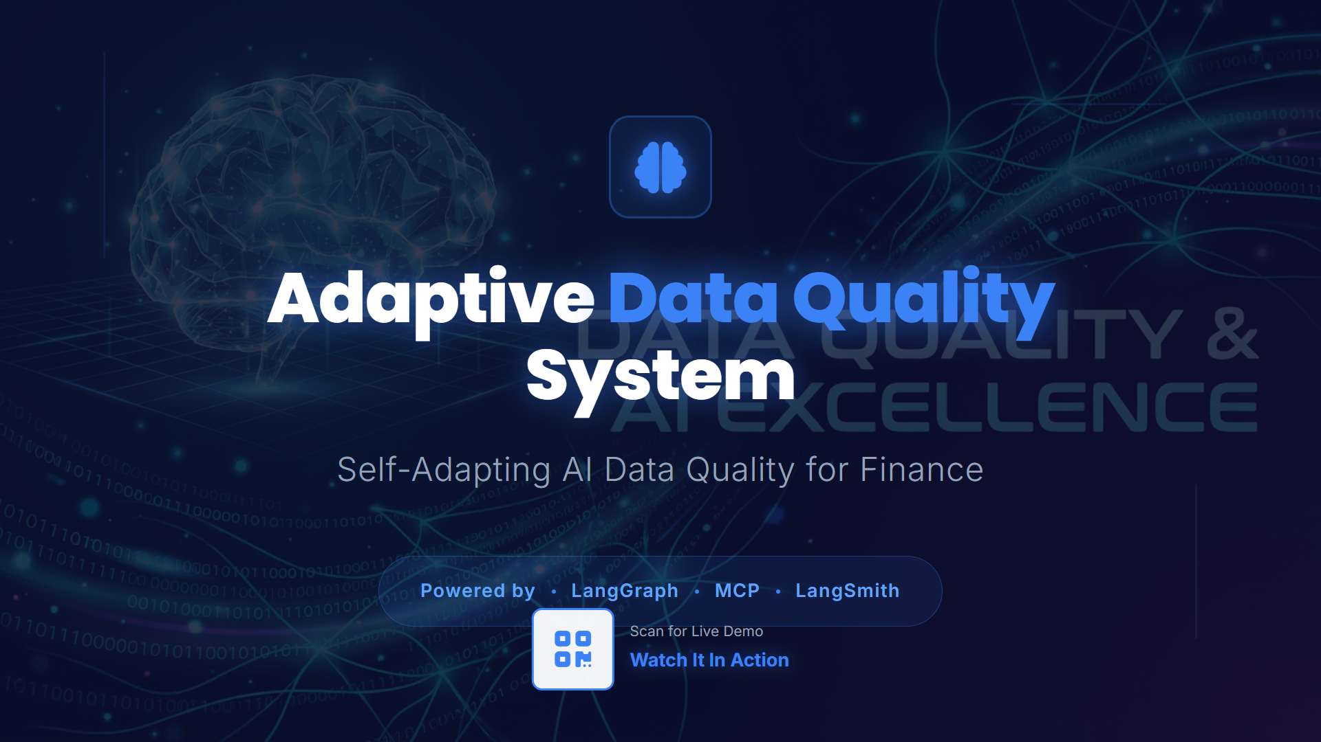

Slide 13
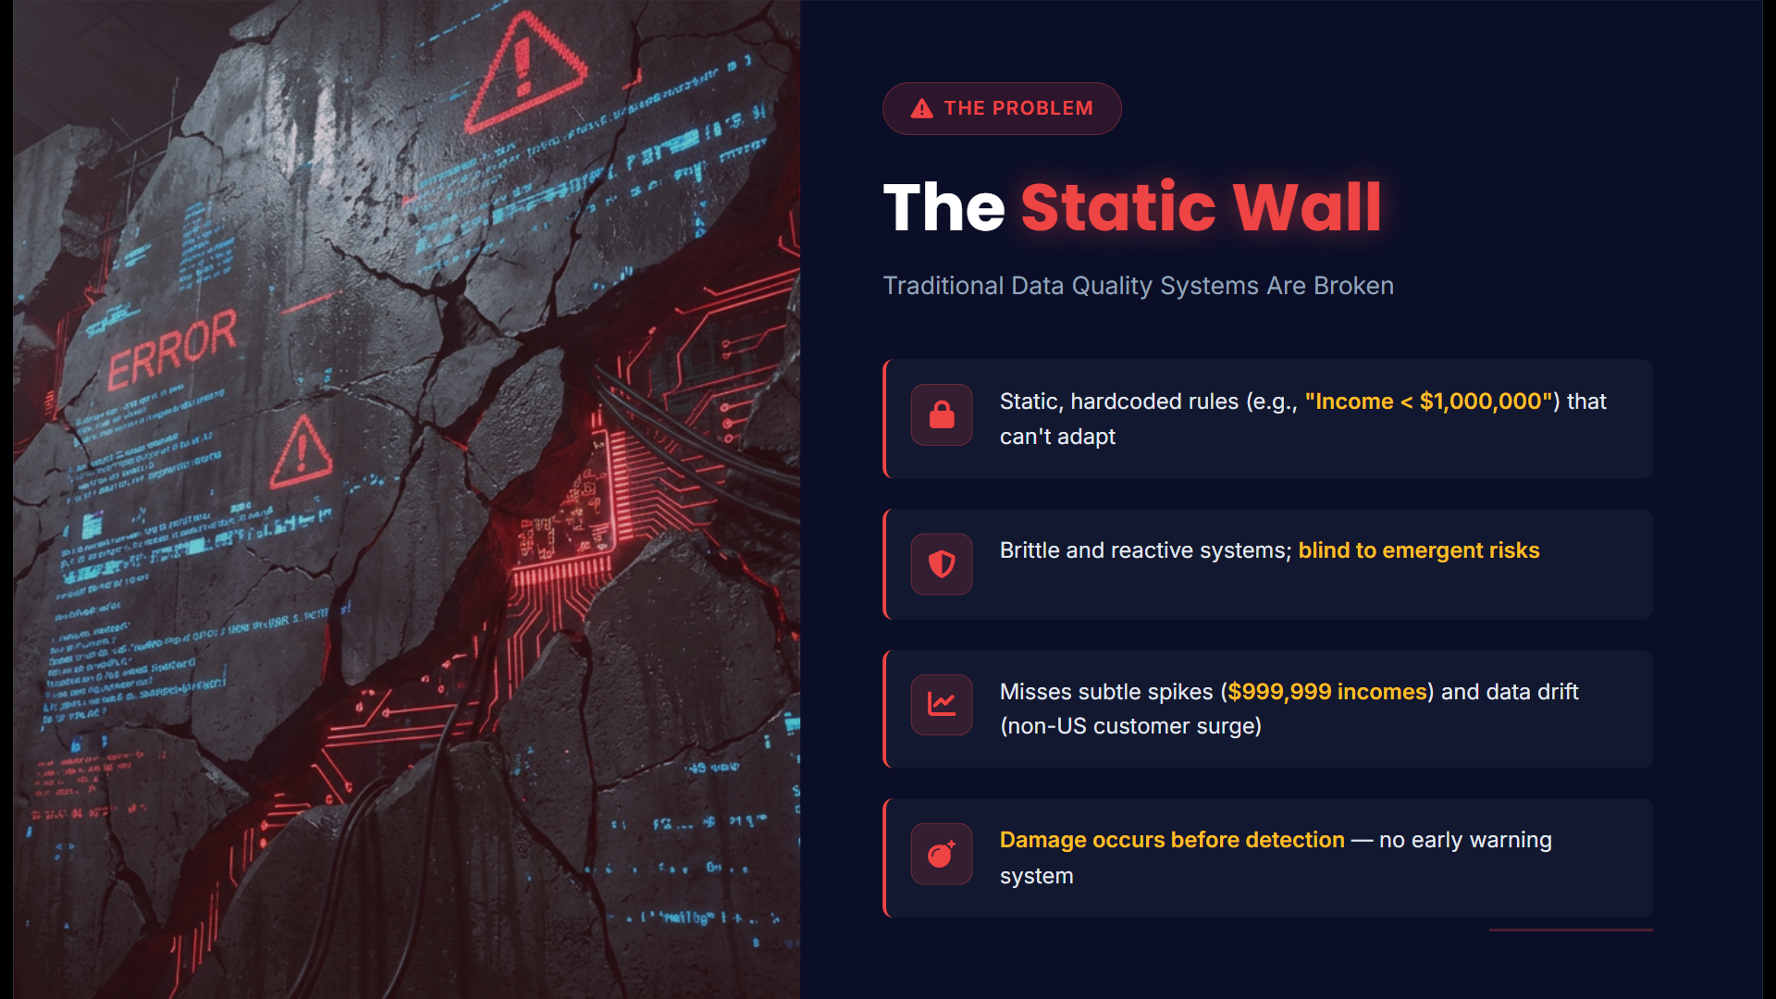

Slide 14
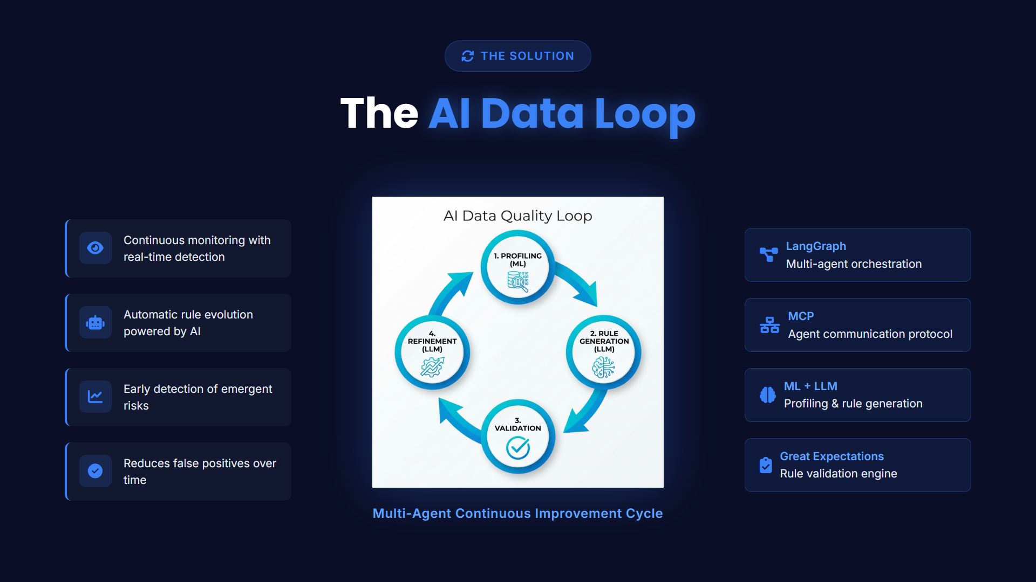

Slide 15
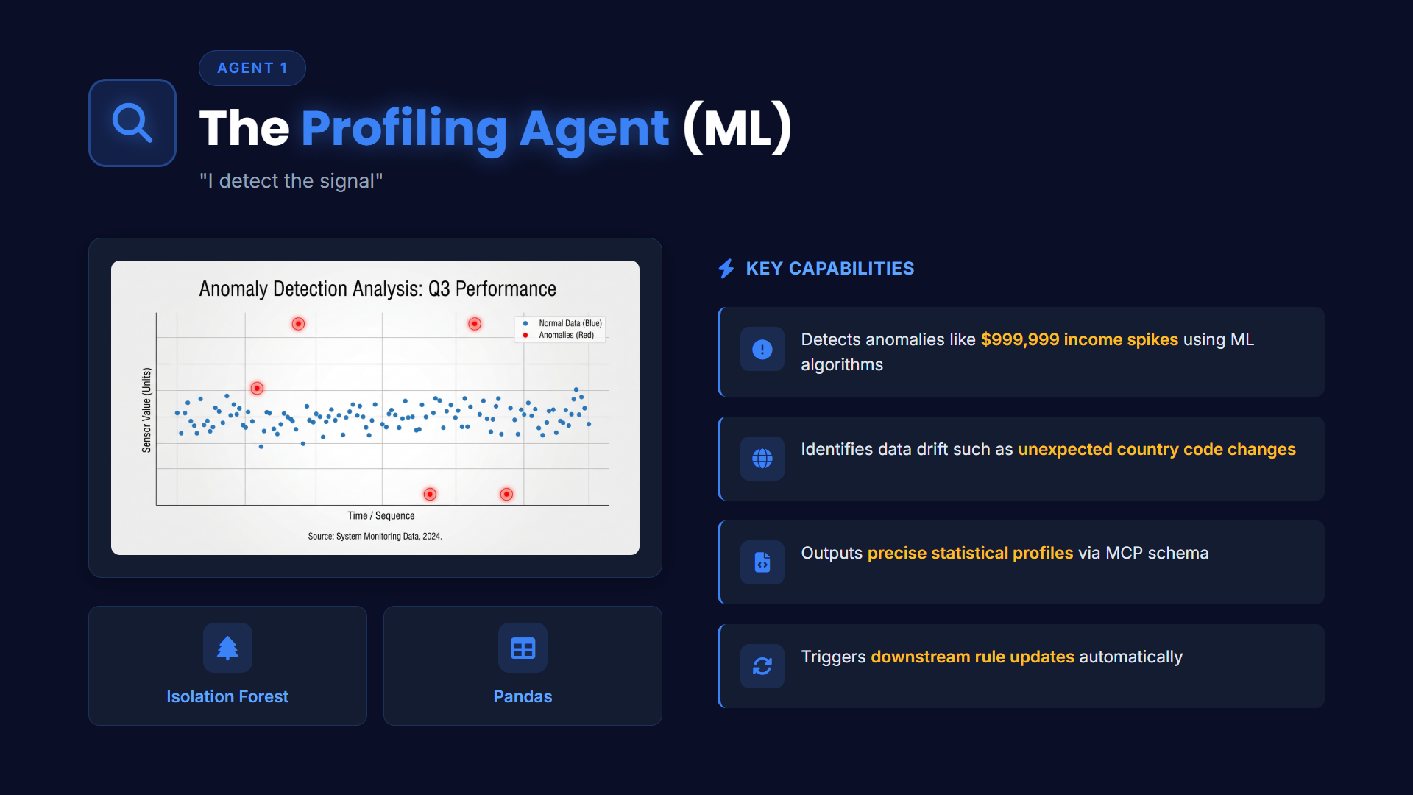

Slide 16
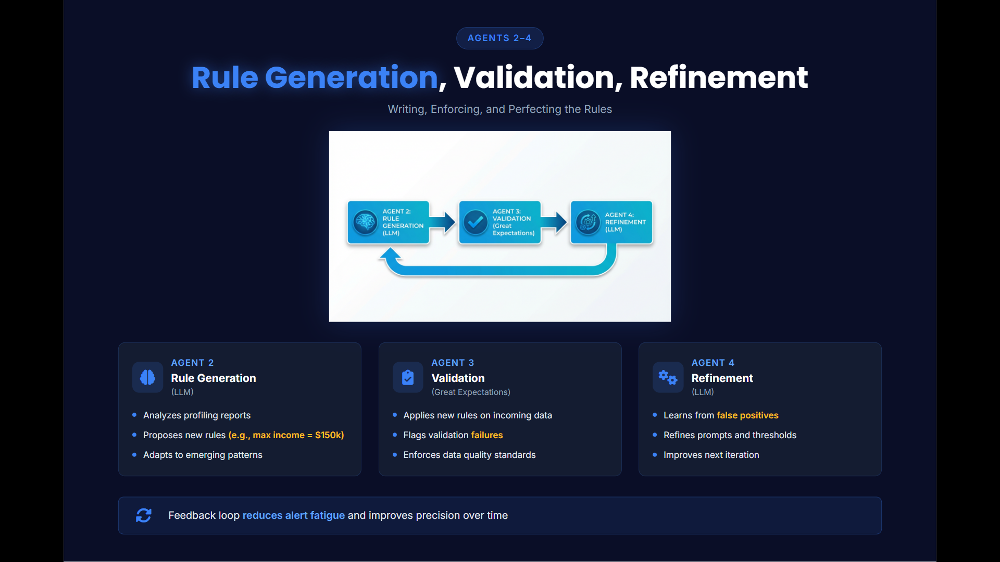

Slide 17
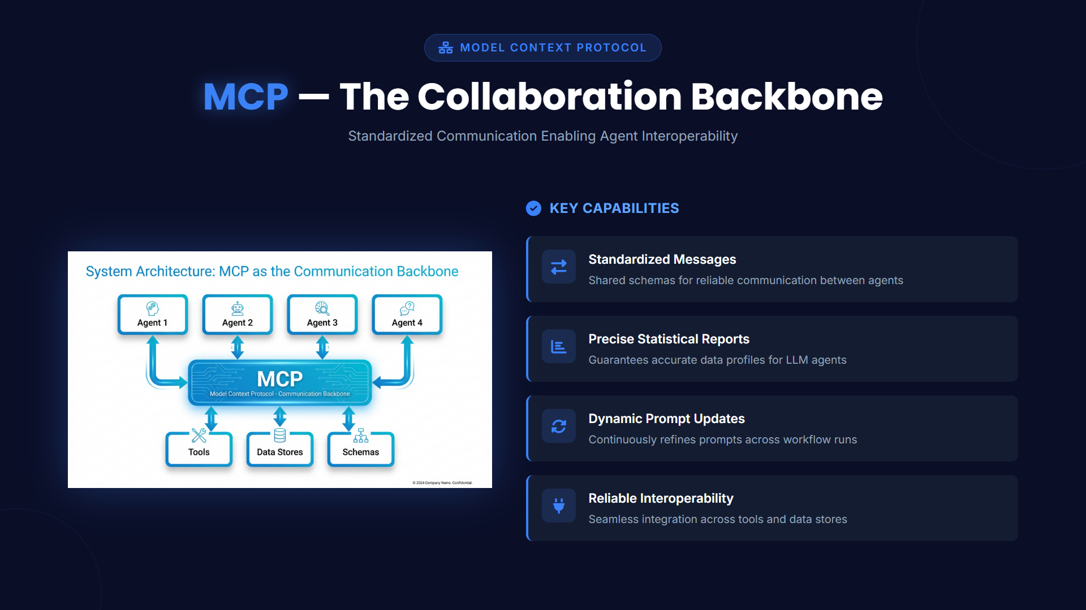

Slide 18
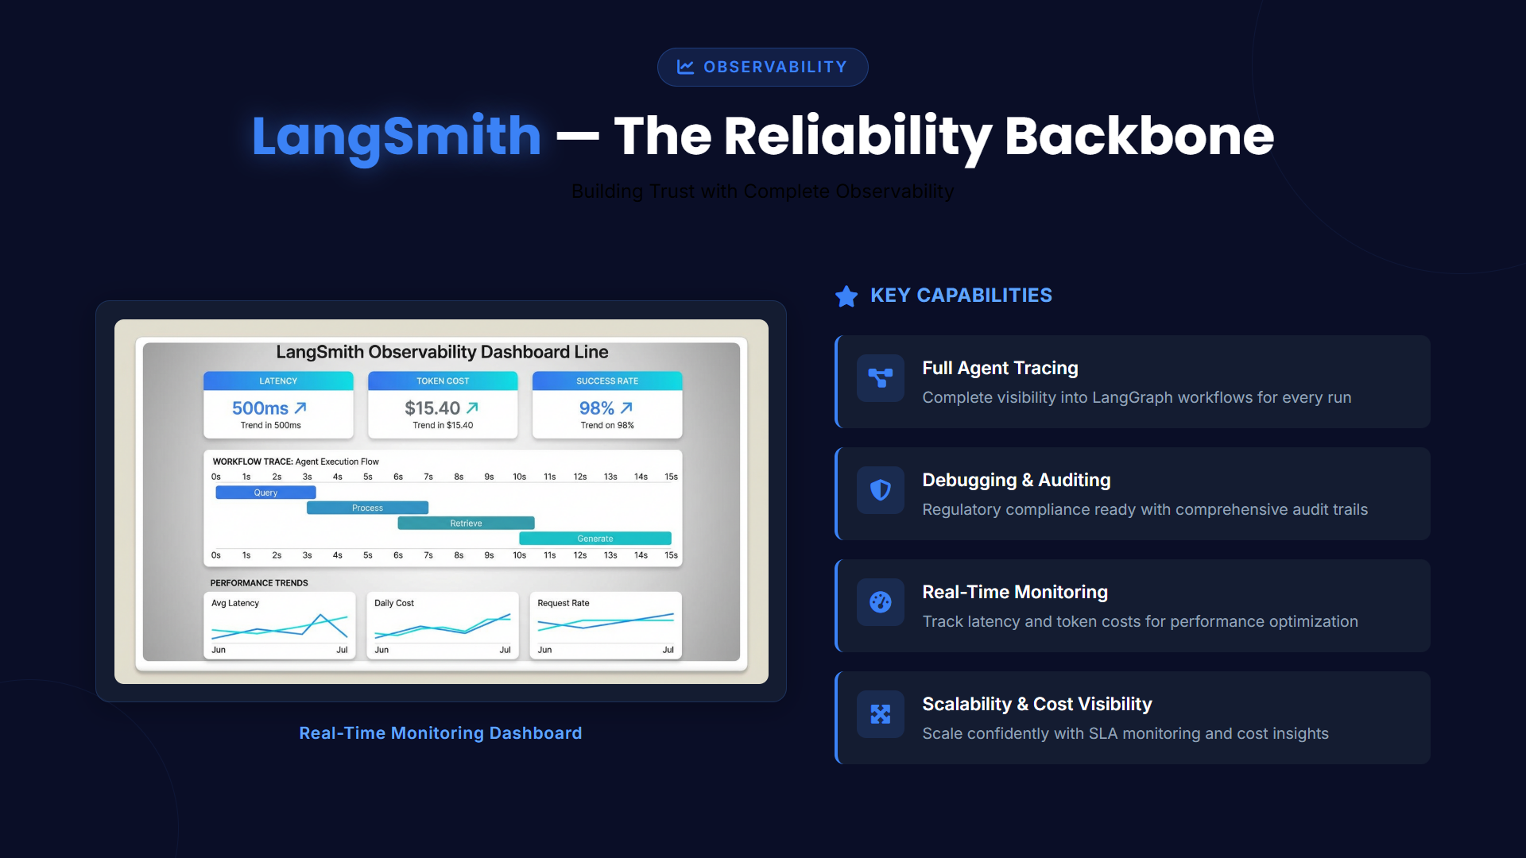

Slide 19
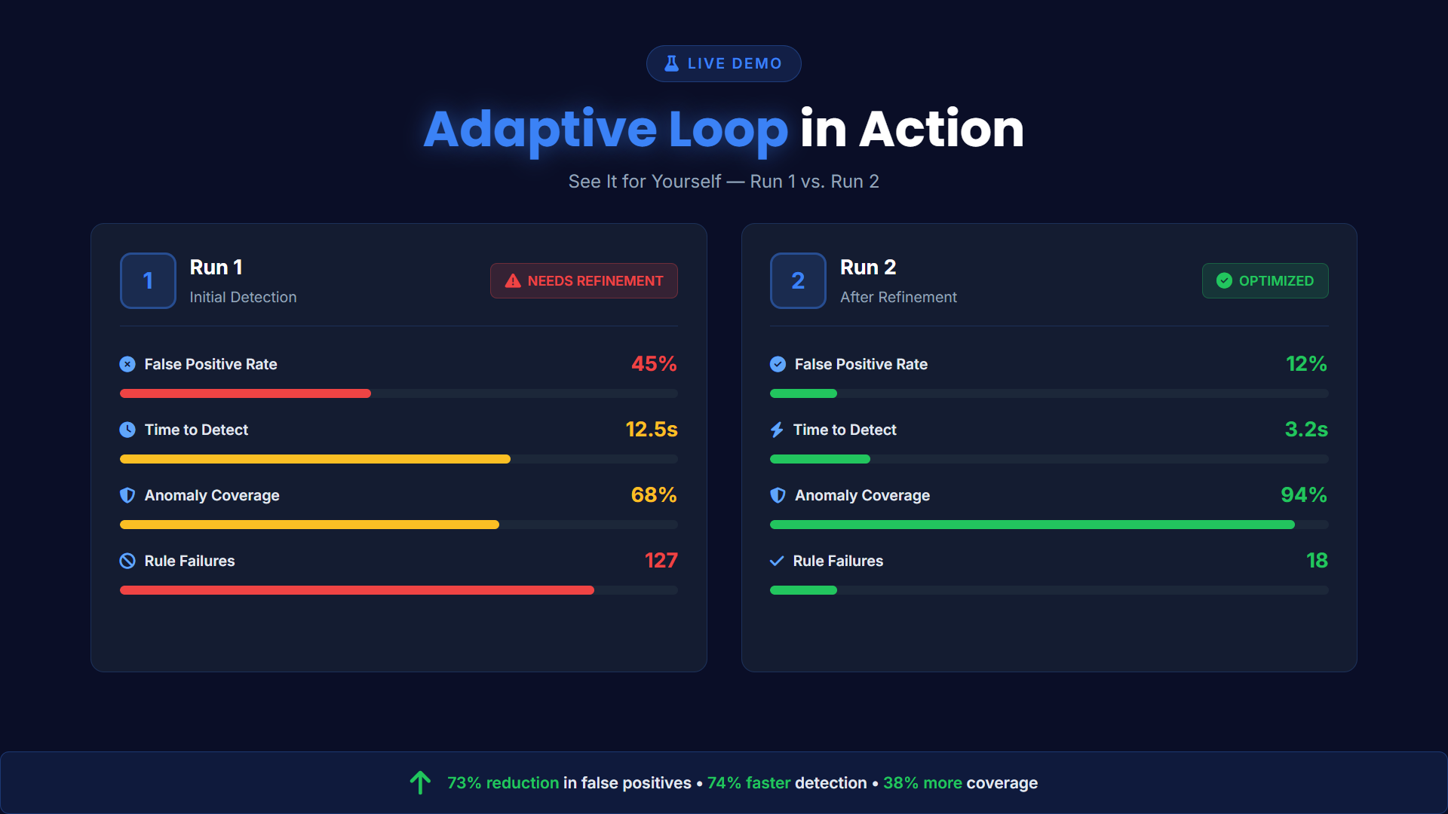

Slide 20
